Slide 1

NYC Vegetarian Restaurant
TripAdvisor Review
Jessie Gong

Slide 2
Web Scraping

Slide 3
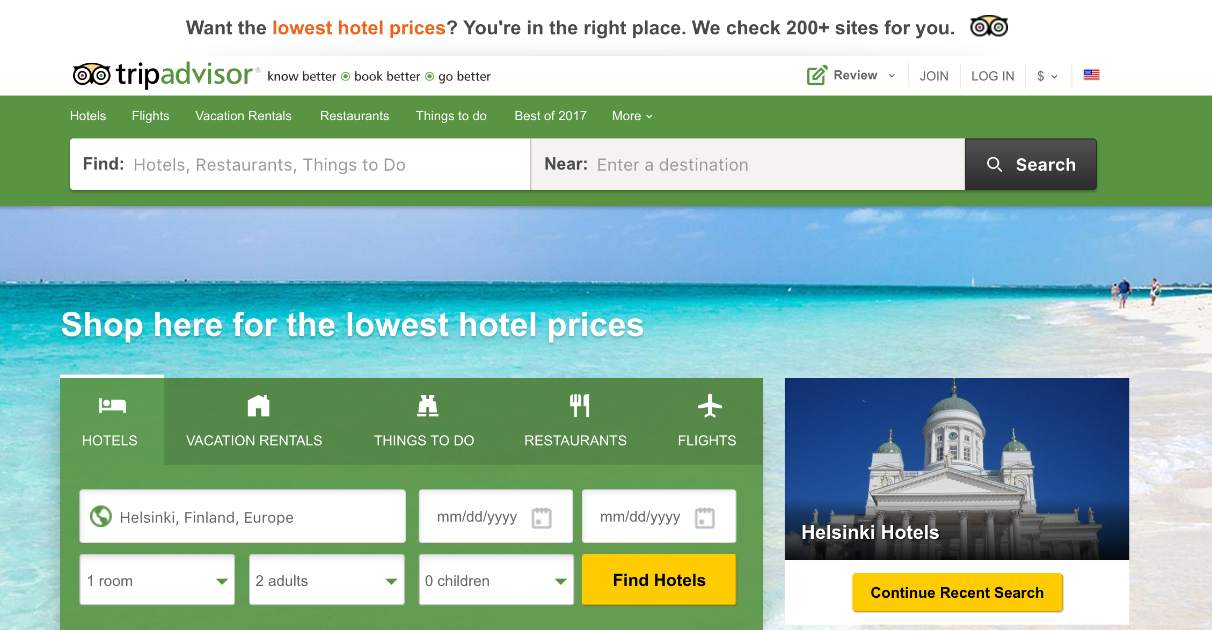
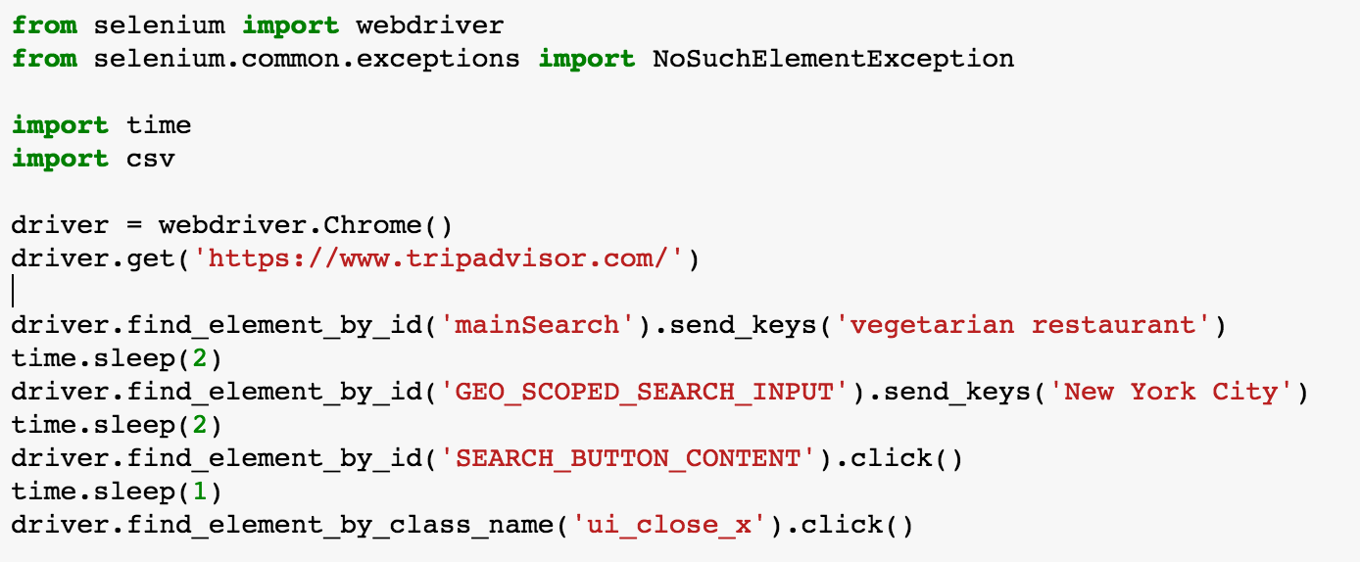
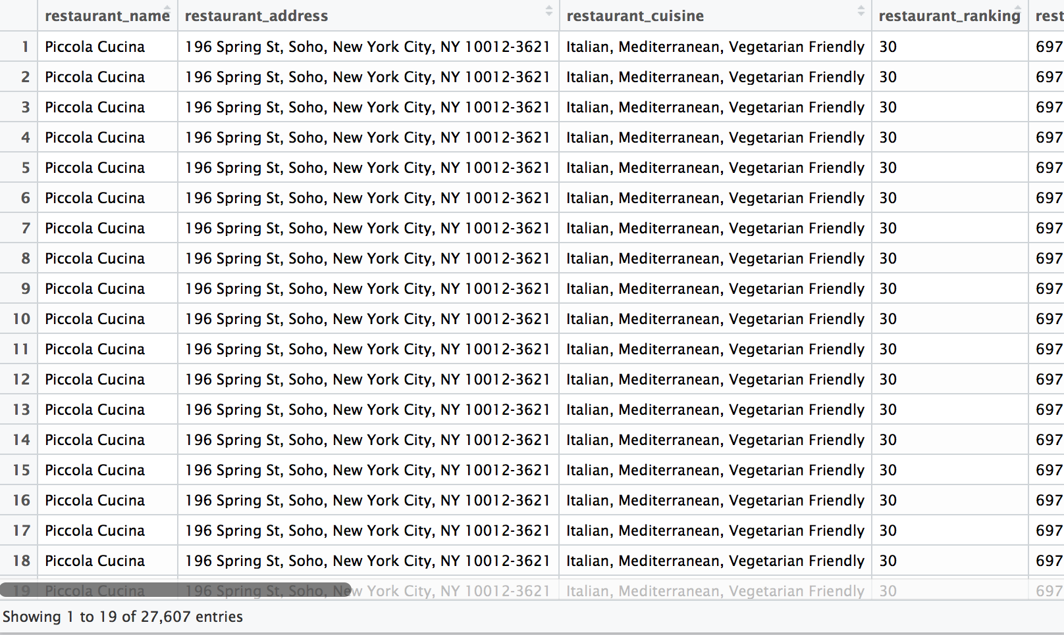
.CSV
356 restaurants
27607 reviews
1

Slide 4
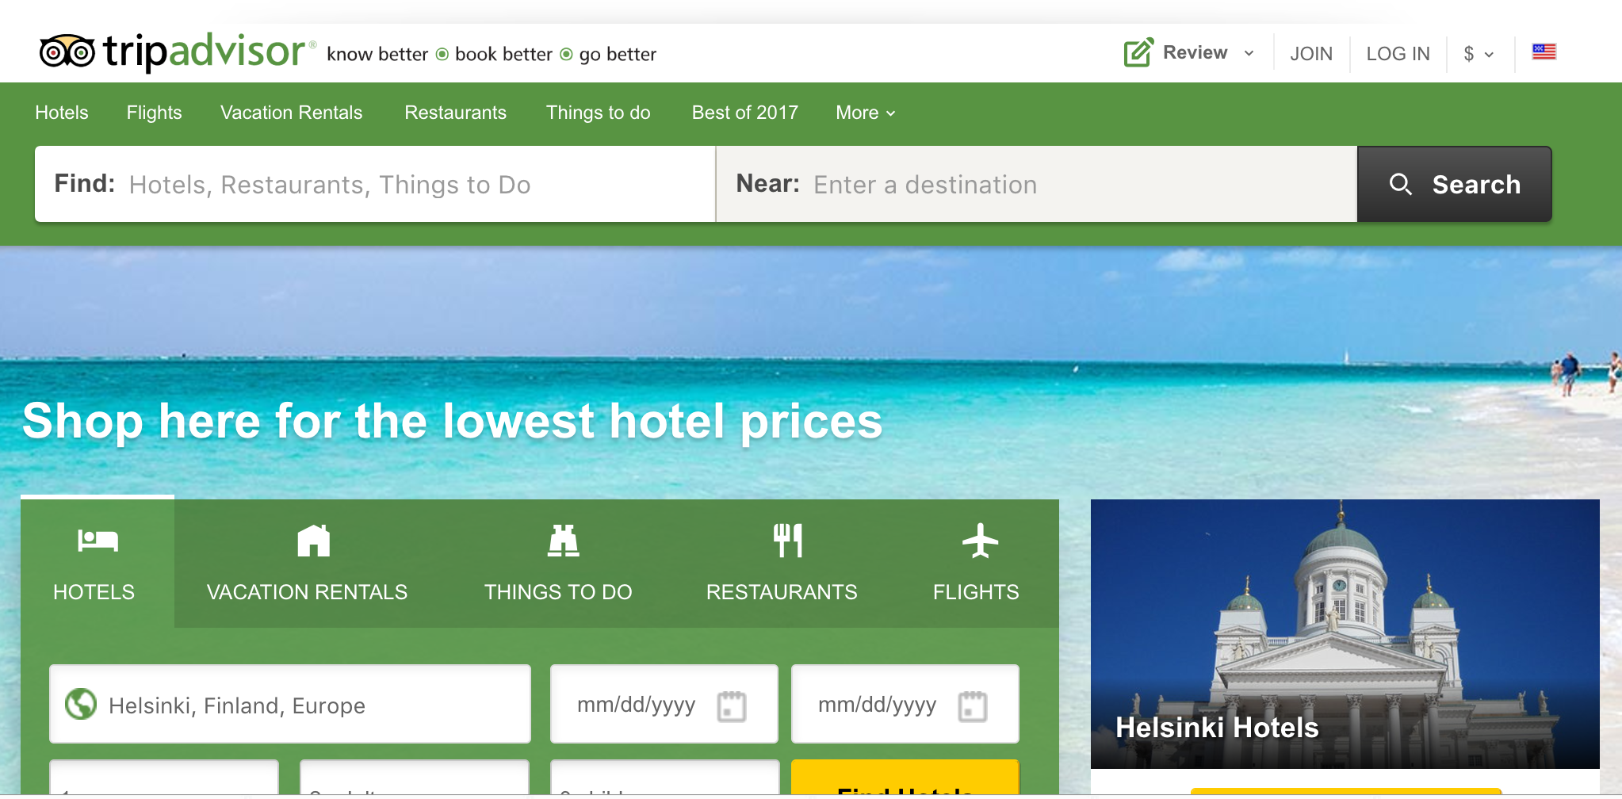
https://www.tripadvisor.com/

Slide 5
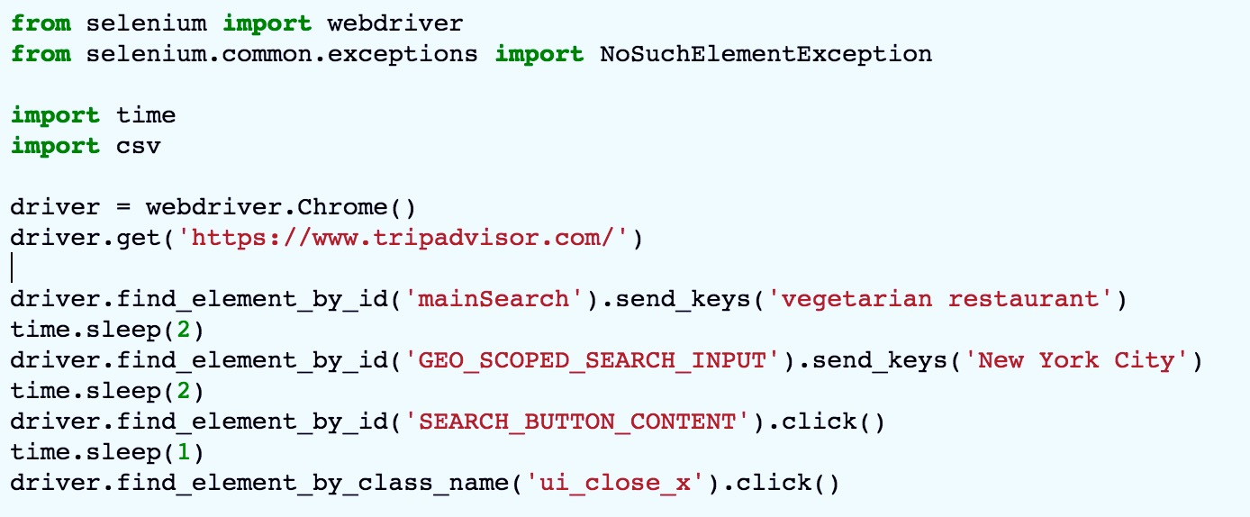

Slide 6
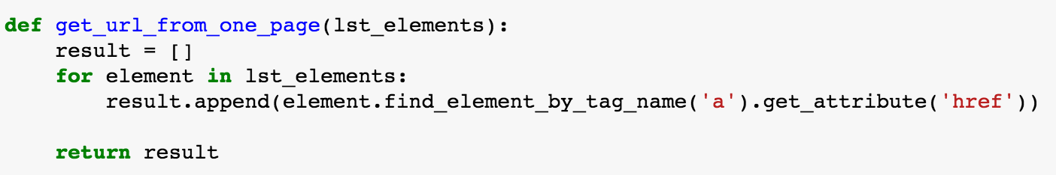
1. Getting restaurants’ urls

Slide 7
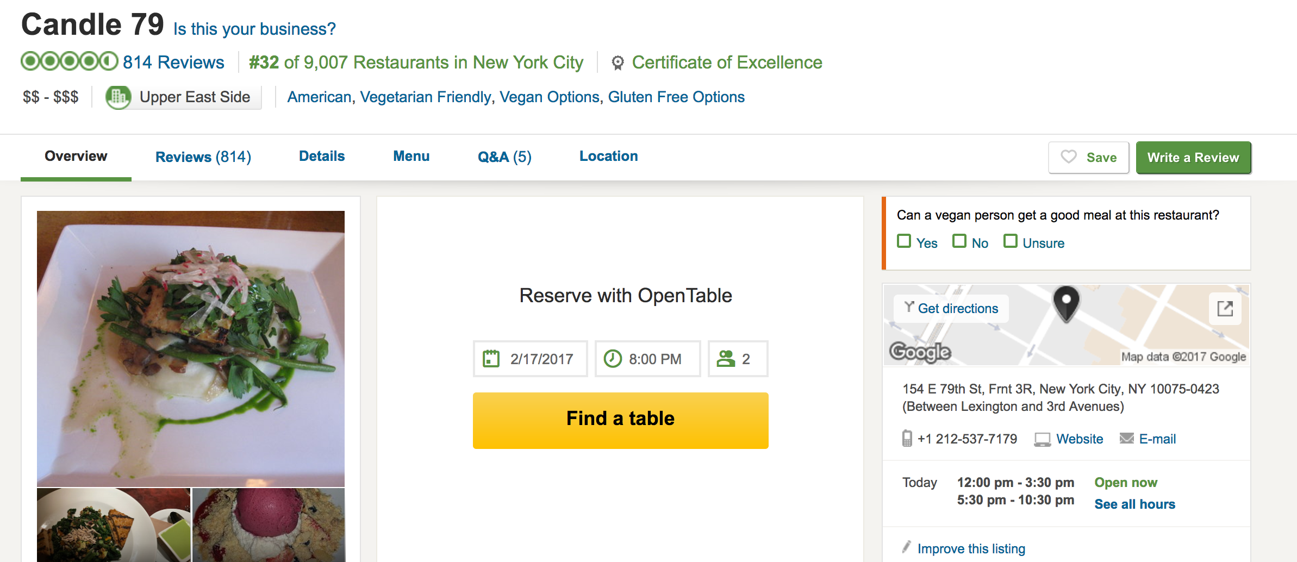
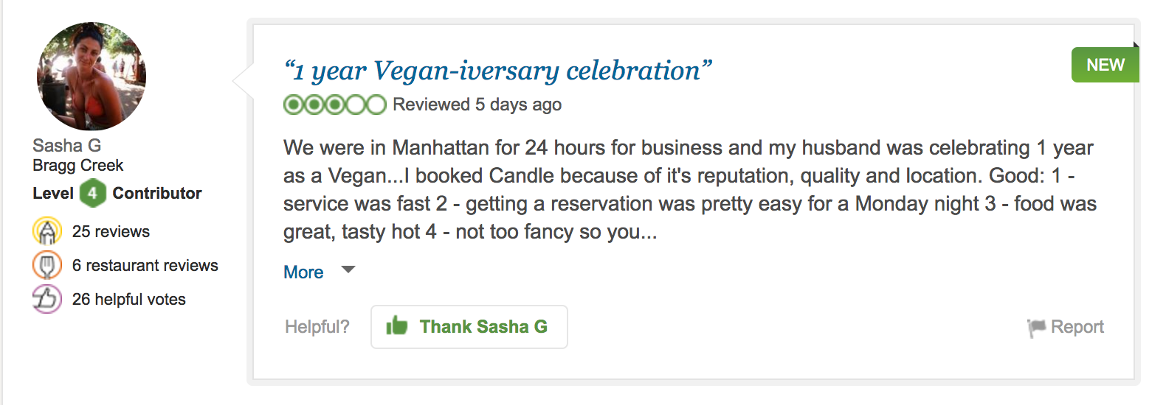
2. Getting data from each restaurant

Slide 8
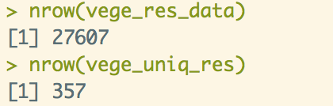
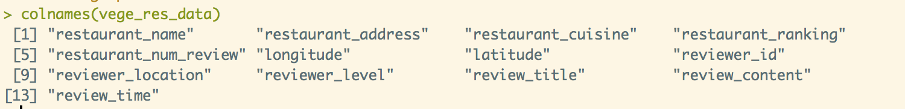
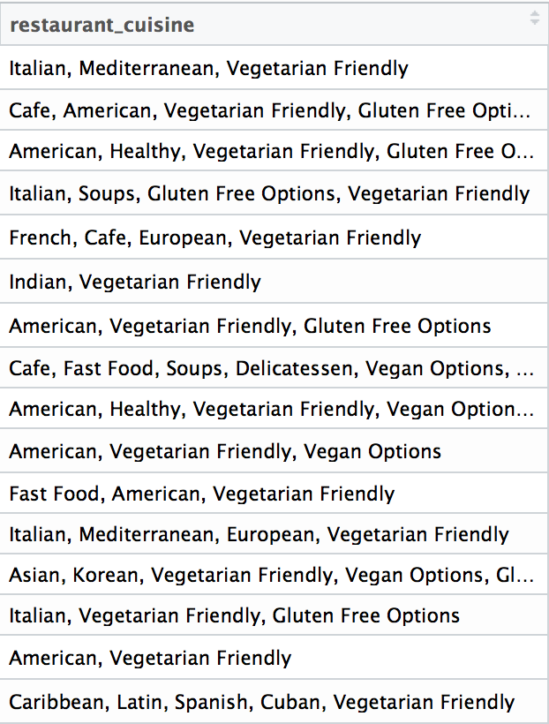
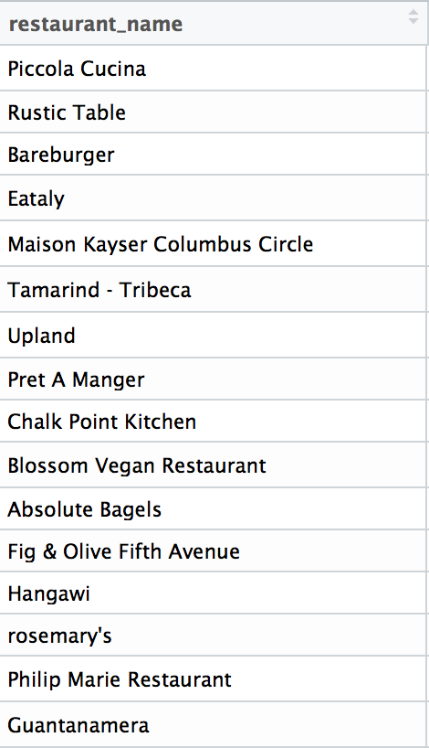
3. Getting dataset

Slide 9
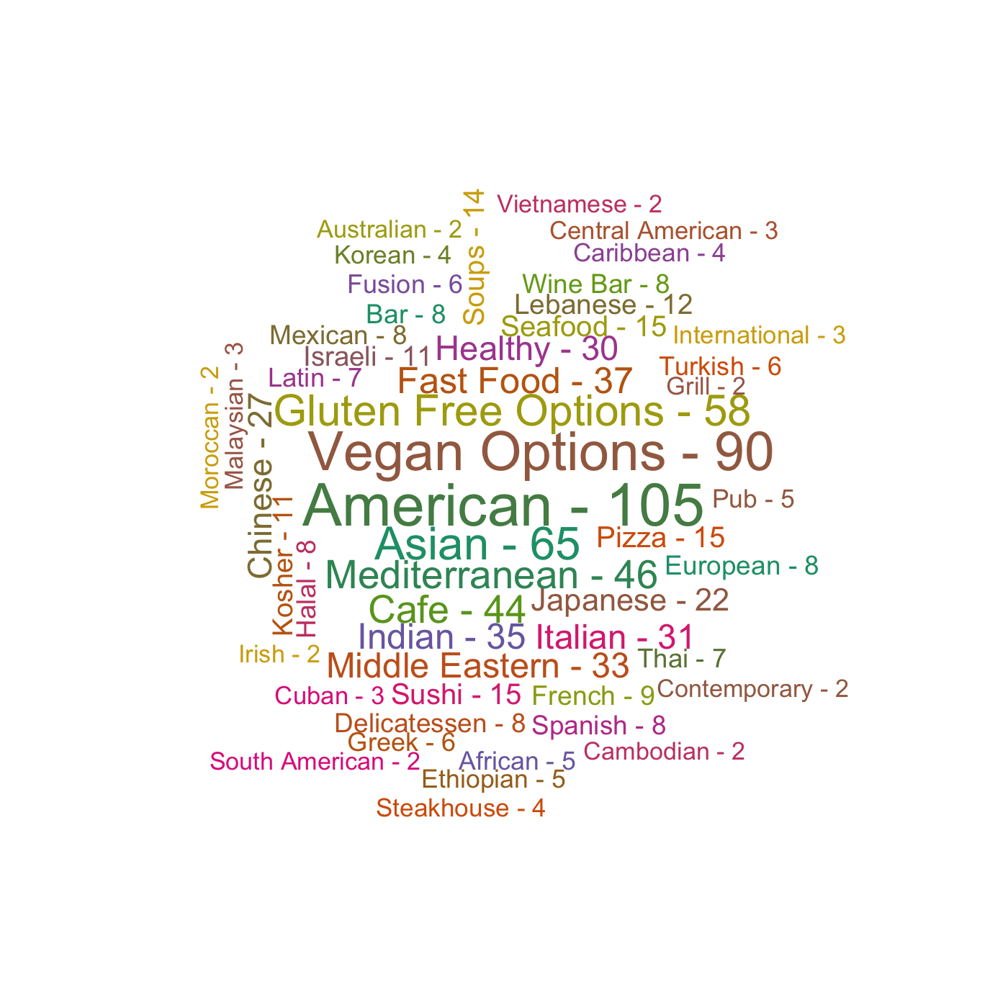
Cuisines

Slide 10
Review Visualization

Slide 11
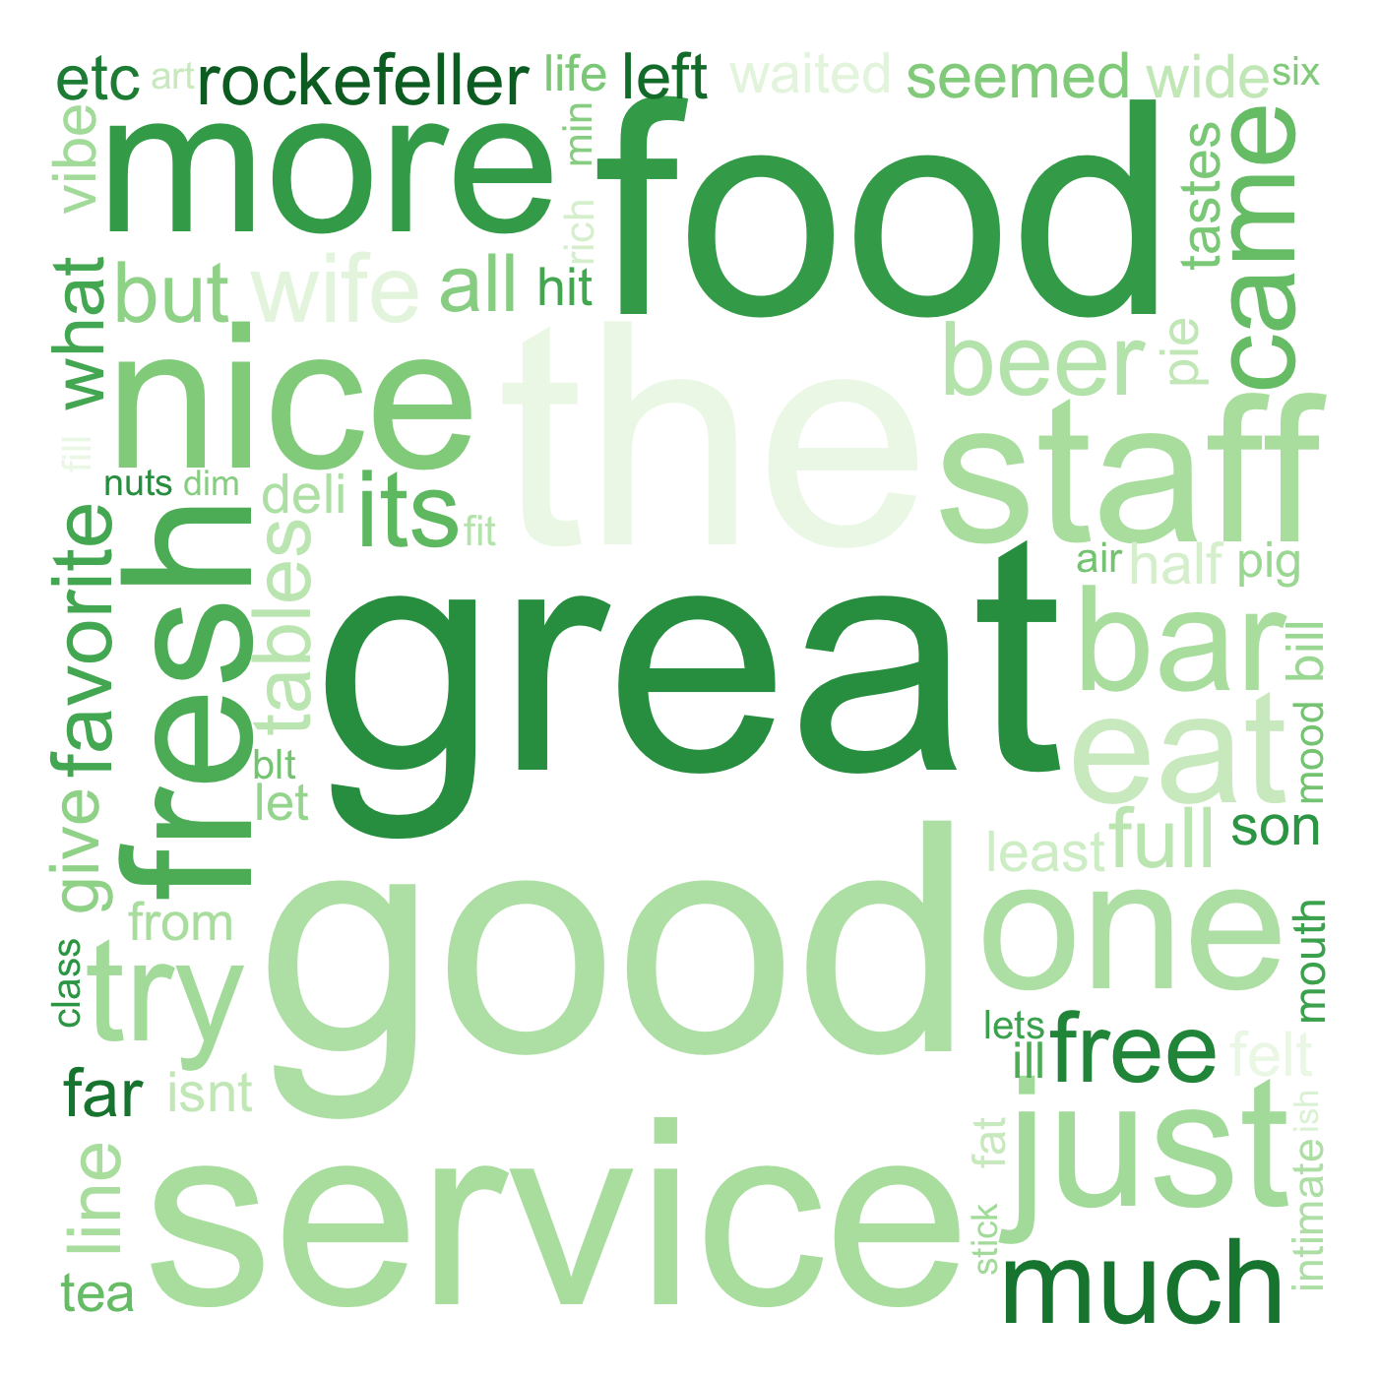
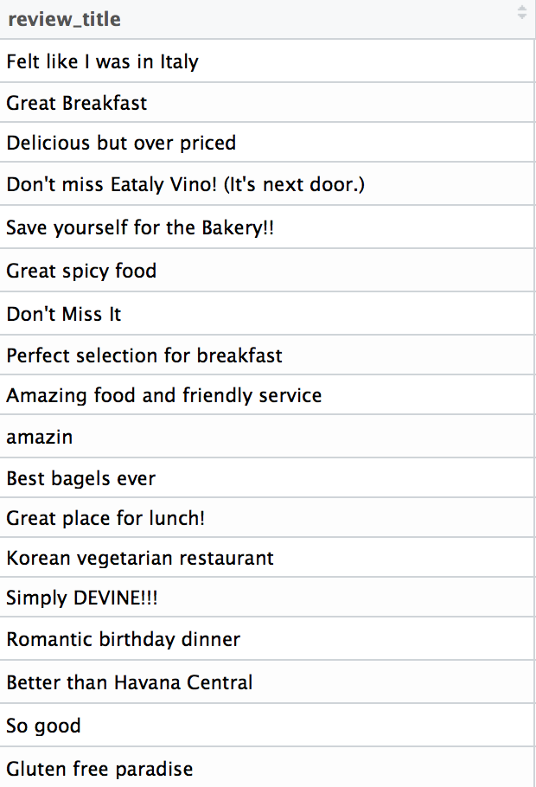
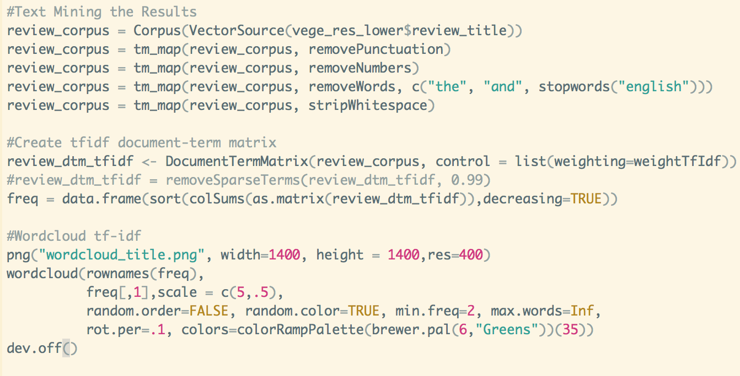
Tf-Idf
Tf (word): frequency the word appears in the current document
Df (word): frequency or number of documents the word appears in the corpus
N: number of documents
Tf_Idf (word) = Tf (word) * log (N / Df (word) )

Slide 12
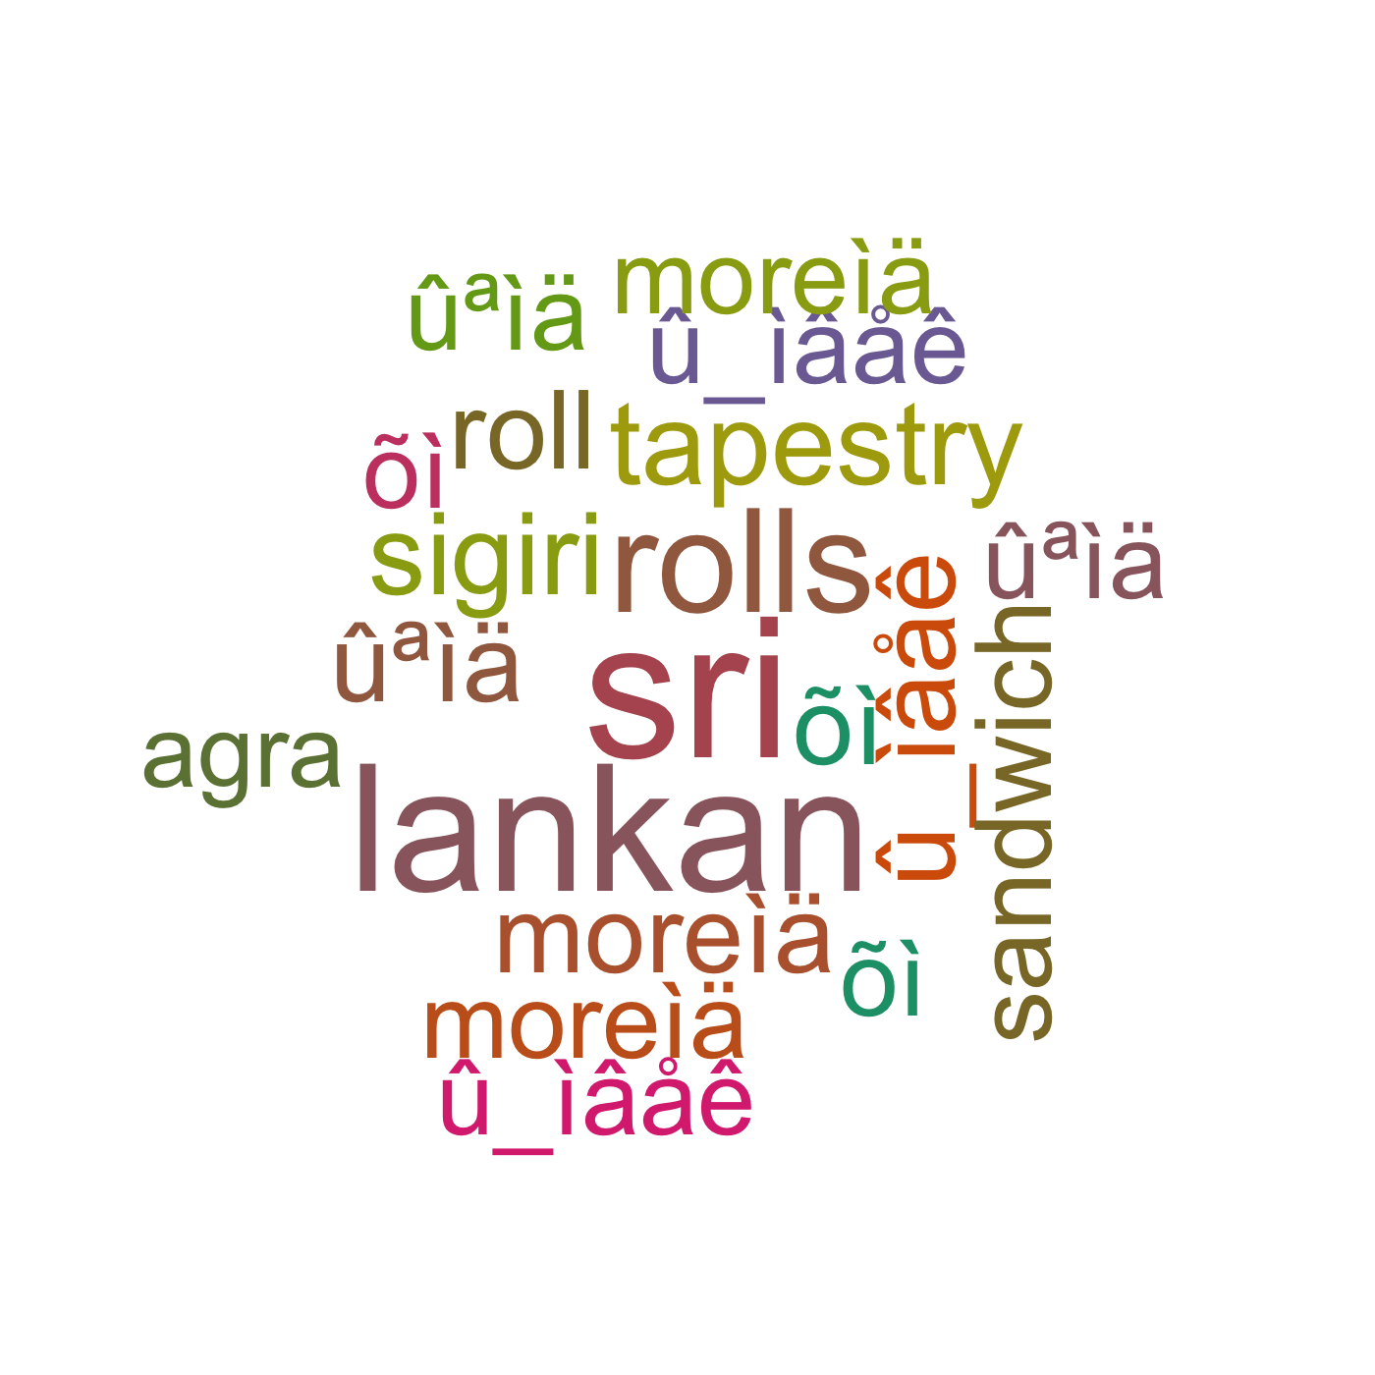
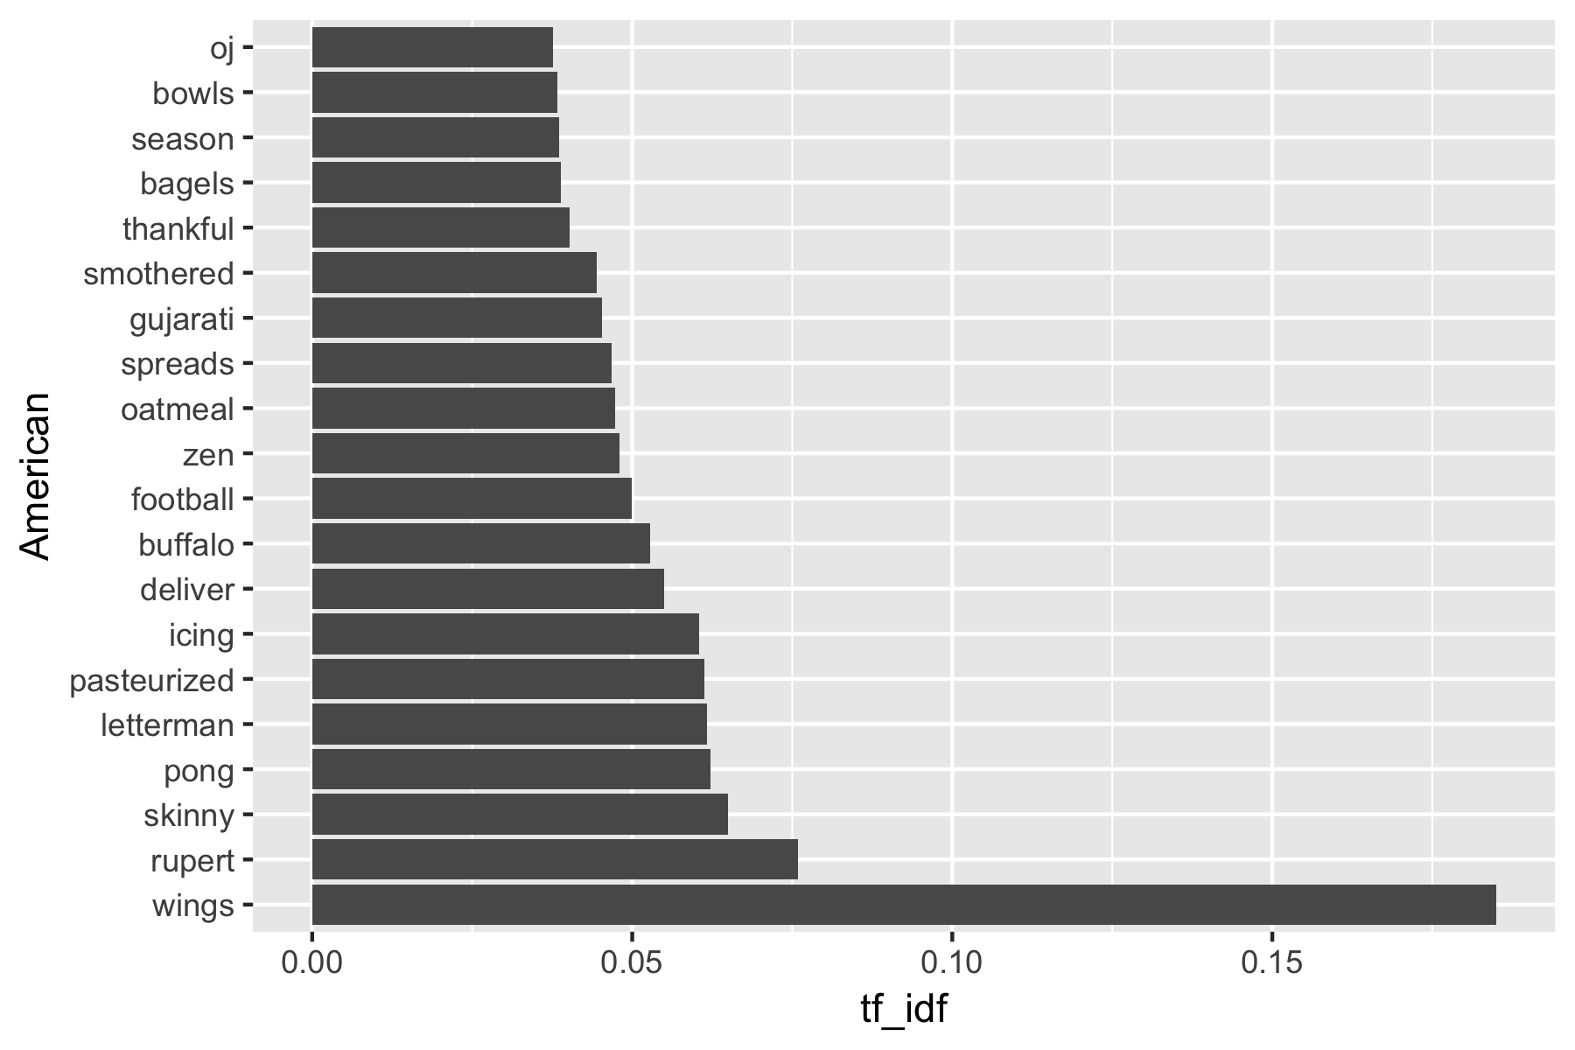
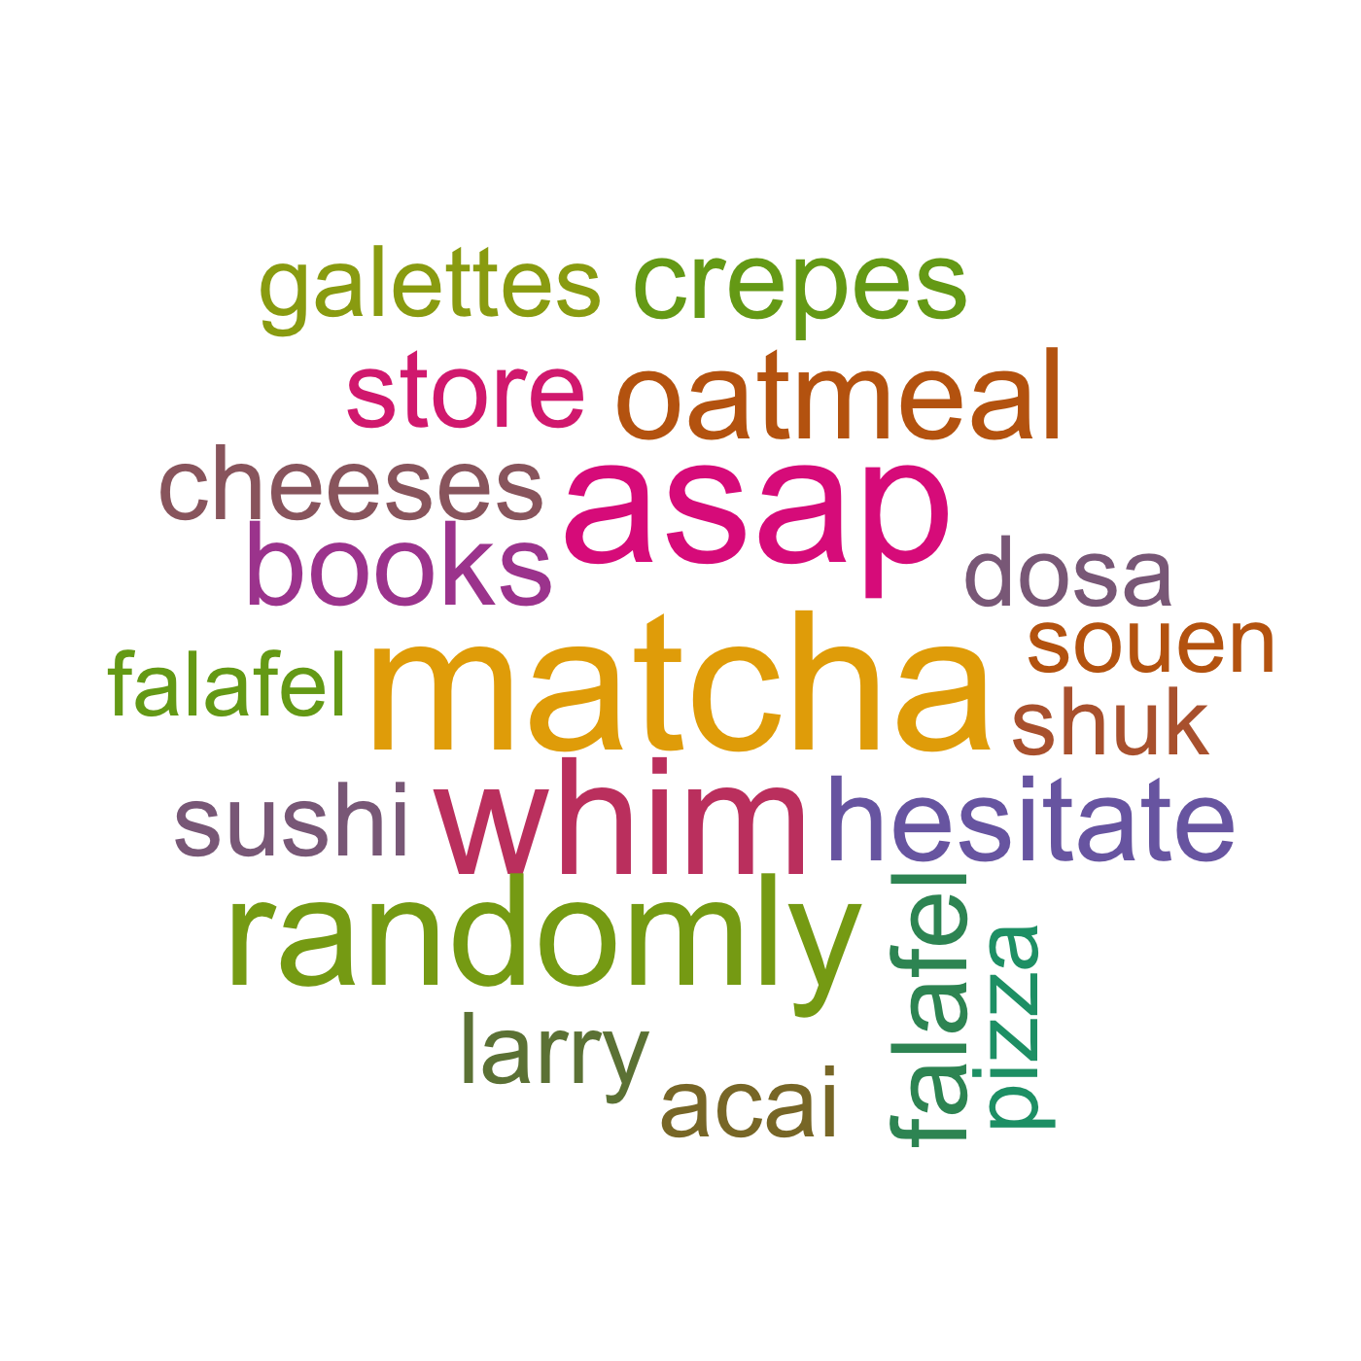
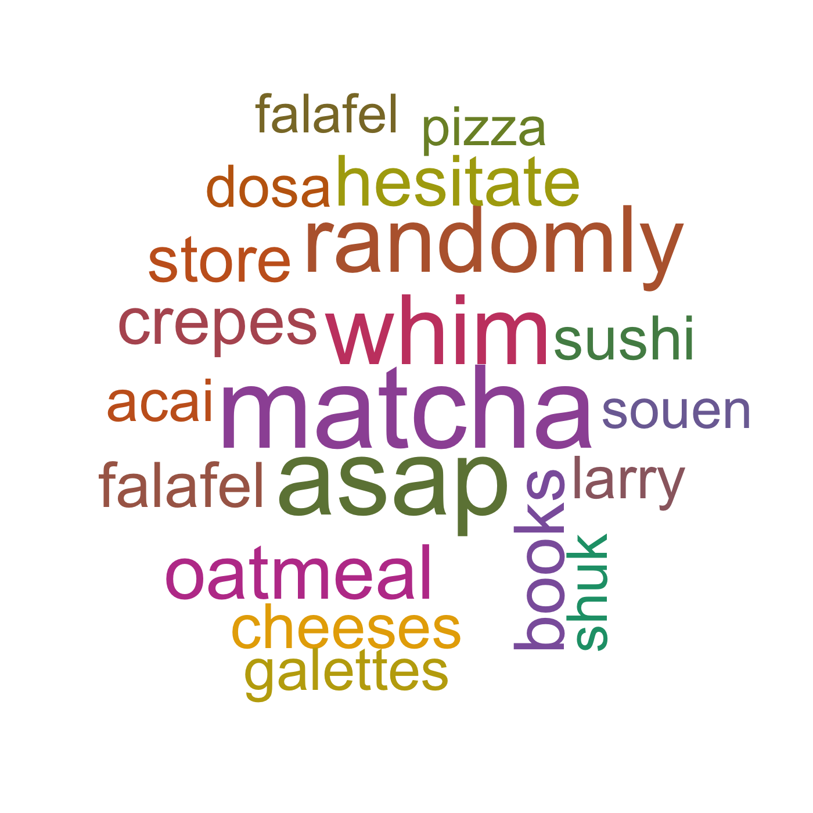
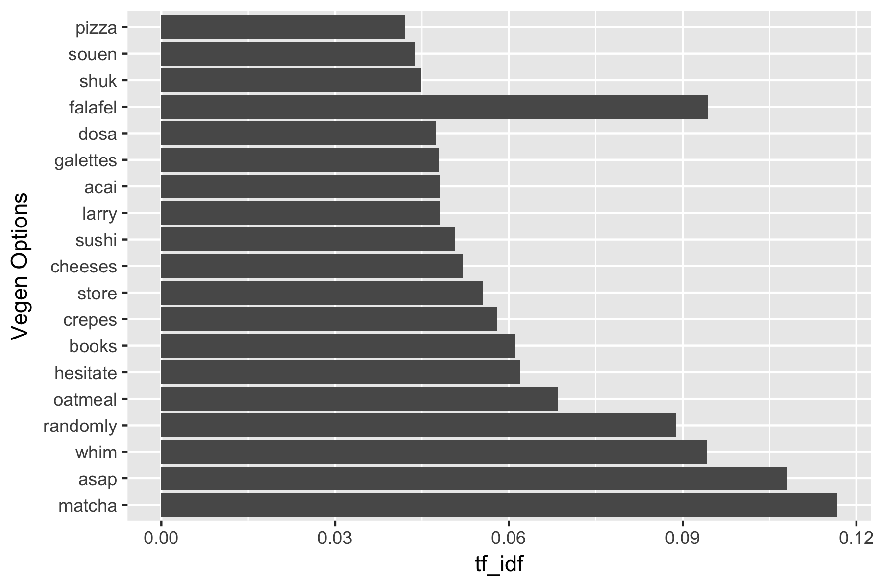
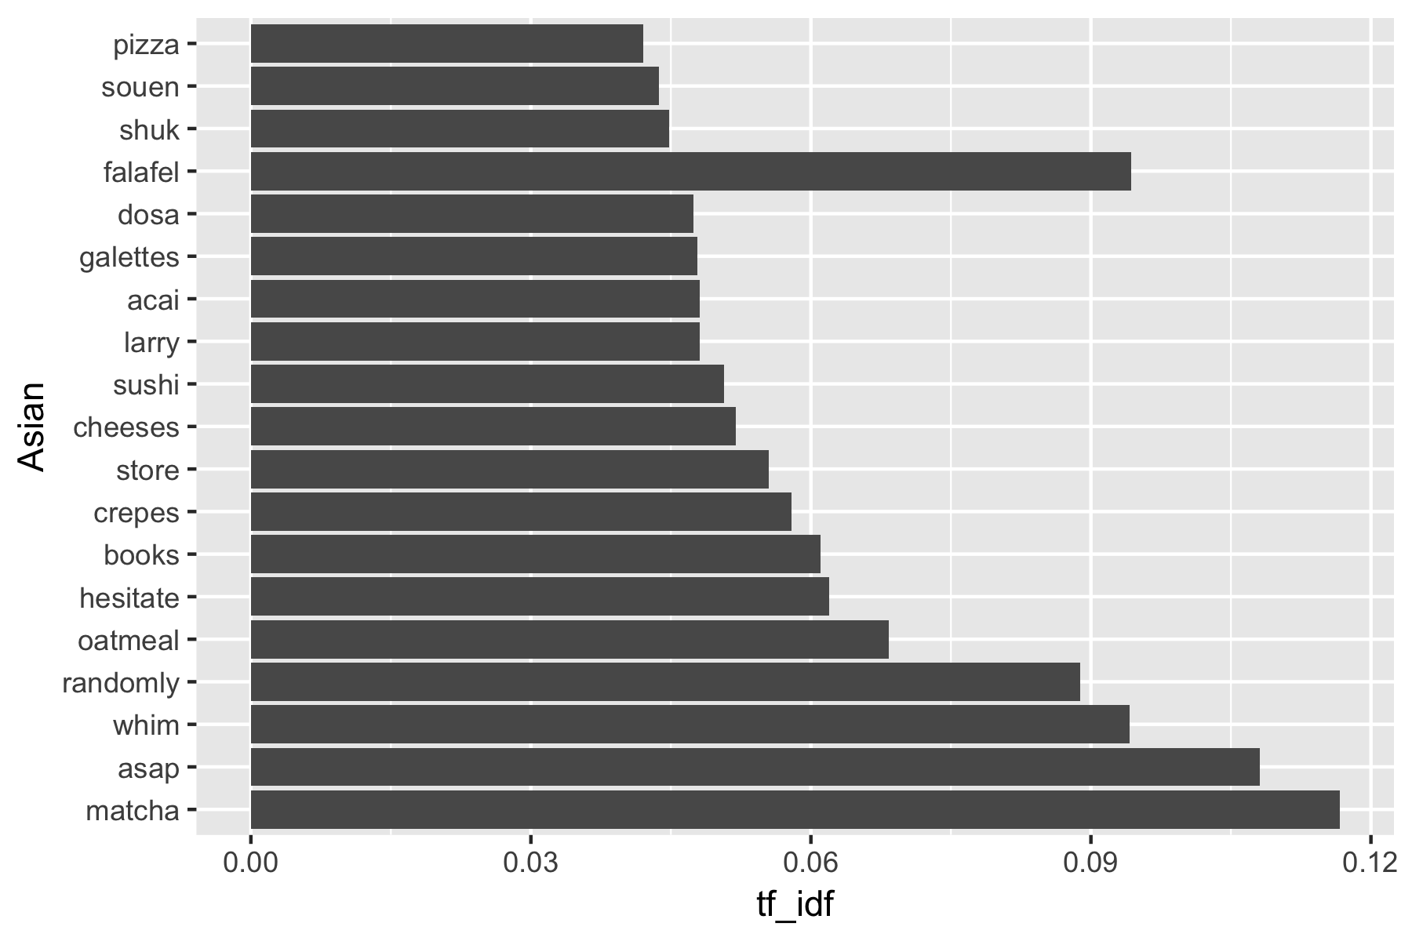
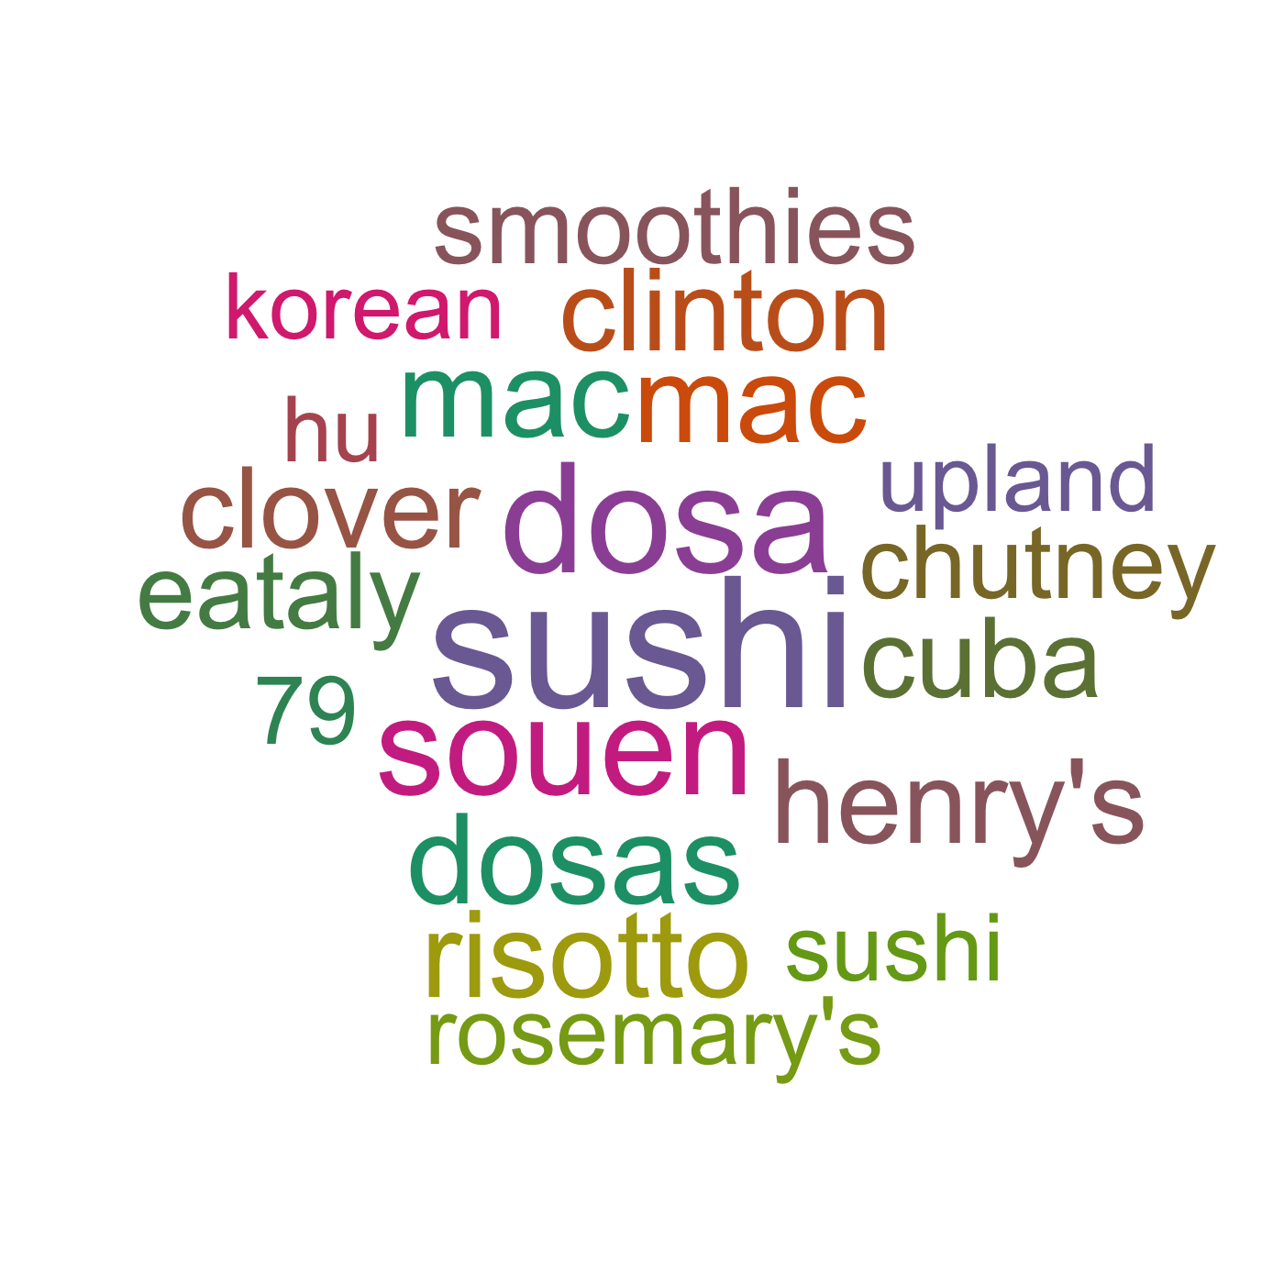
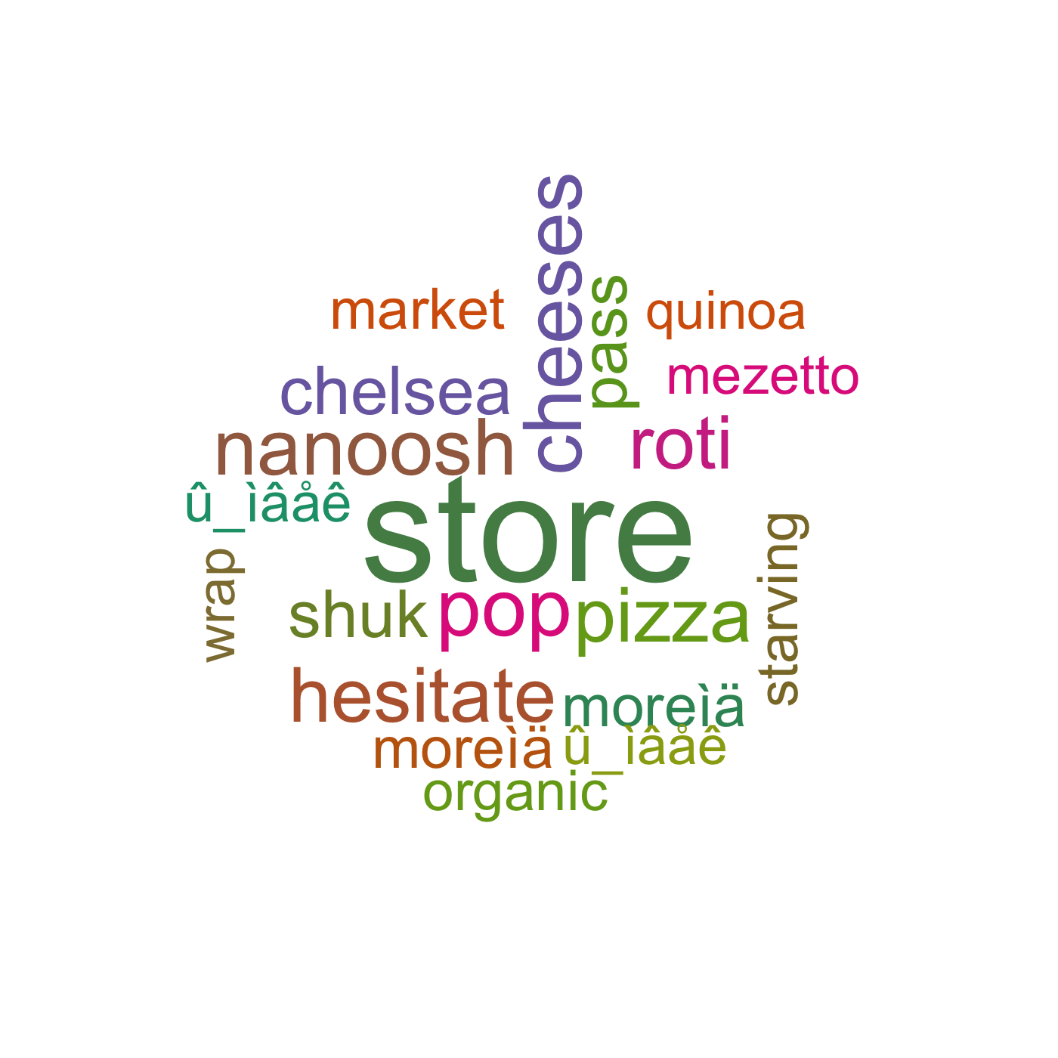
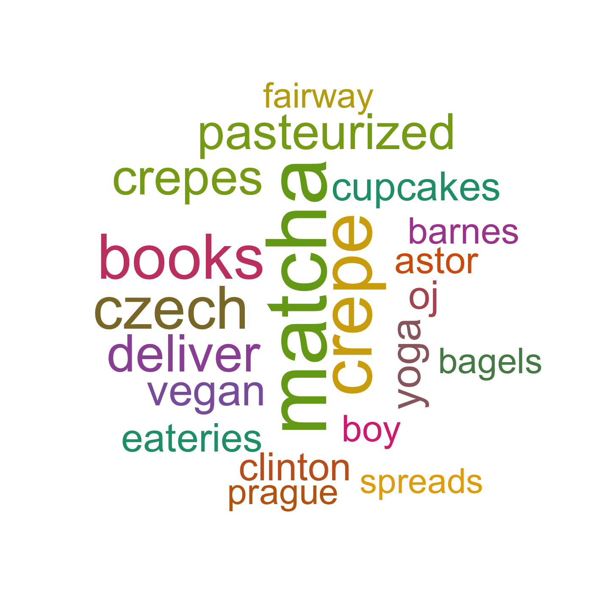
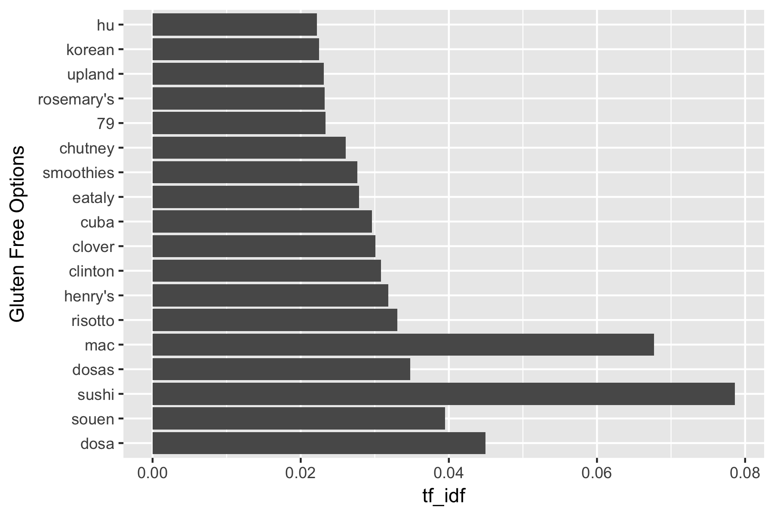

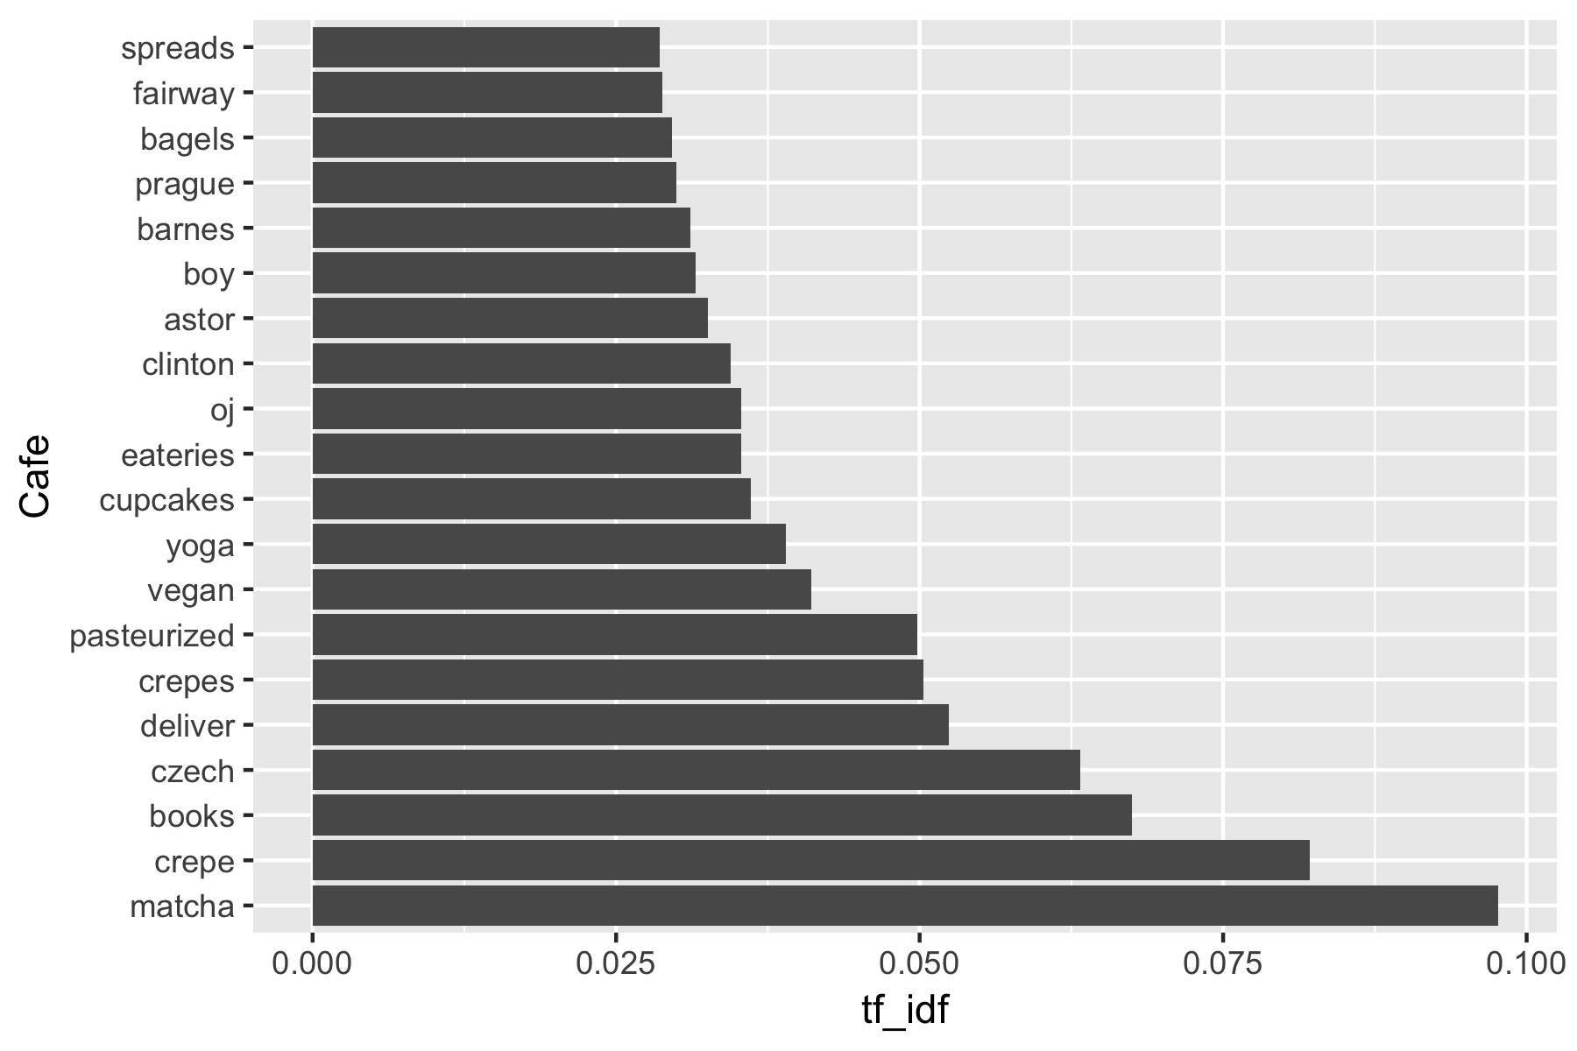
American
Vegan Options
Asian
Gluten Free Option
Mediterranean
Cafe

Slide 13
Recommendation system

Slide 14
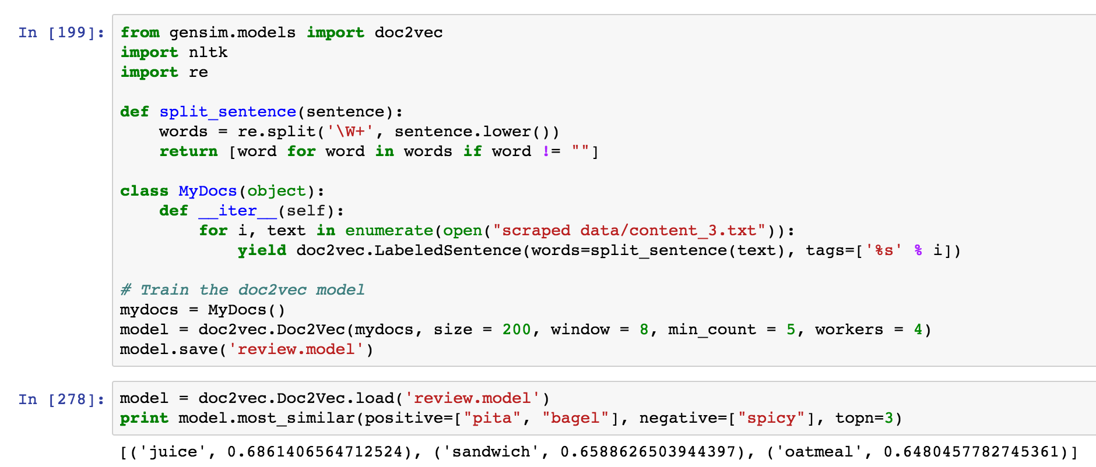
Doc2Vec
Convert word documents into vectors
Notes:
Using review text to train the model, then print an example
Print the top 3 words similar to “pita”, “bagel”, different from “spicy”
Juice, sandwich, oatmeal

Slide 15
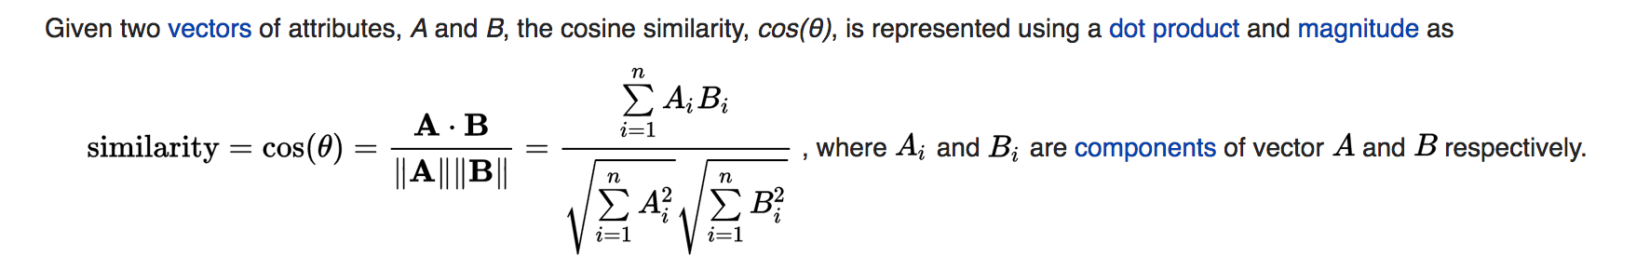
Cosine Similarities
Notes:
Similarity is the core of recommendation system. The model will find the most similar review based on the requirement a user gives.

Slide 16
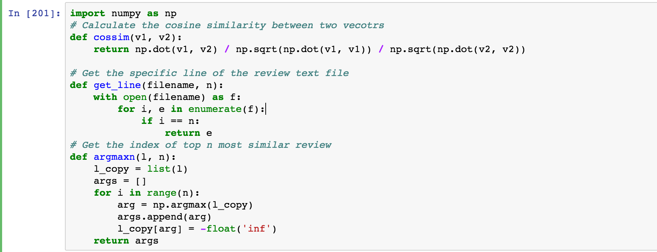
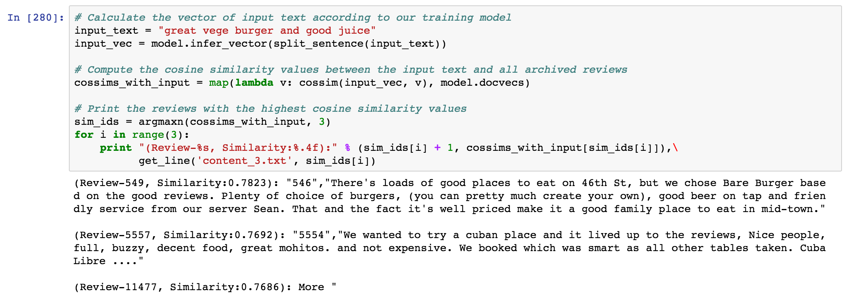
Notes:
After defining Cosine Similarity Function, I write a input “great vege burger and good juice “

Slide 17
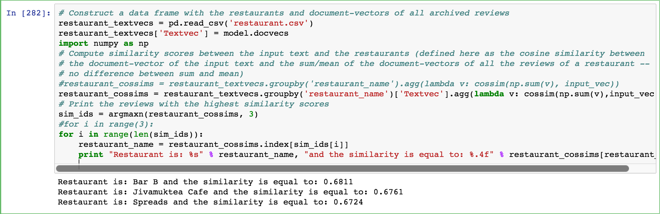

Slide 18
Short come & Future work
Notes:
Unsupervised a

Slide 19
Thank you!

